Slide 1

Typescript Short Tutorial
Based on Essential TypeScript 4
By Adam Freeman

Slide 2
Why Typescript
Javascript is must have but very unstructured, dynamic and difficult to manage for enterprise applications. Typescript is a solution for such issues.
Web Assembly is the future, a major platform for the web. Node.js and JavaScript is a perfect match with Web Assembly. AssemblyScript is a TypeScript like language for Web Assembly. TypeScript + Assembly Script is the future for both client and server programming.
Ethereum and other digital currency are also moving to webassembly, and AssemblyScript will help us write Smart Contracts.
Typescript help us learn OOP paradigm very well. Could help you to learn other languages like Go, Python, C# , and Java.
Due to well defined structure, you can enjoy many IDE support like Intellisense and error identification on the fly

Slide 3
Creating a Todo List in
typescript (Hands on)
We will start coding in small iterations. Start from basic and go the to complex

Slide 4
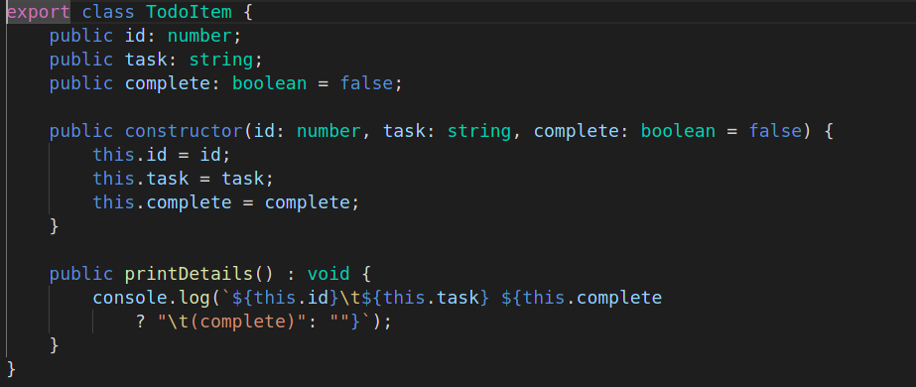
Creating a Todo List:
the Model (Represent single object ⇒ data (attributes) and method(operaitons) related to a single task
Class is the key component in typescript
It has attributes (id, task, complete) that holds data
And method that are used to perform operations(printDetails). This is very simple class. Will complex later on
constructor is a method that runs anytime when we call the class
Note: Only for explanation, Use the book code and repo for copy paste and run codes:

Slide 5
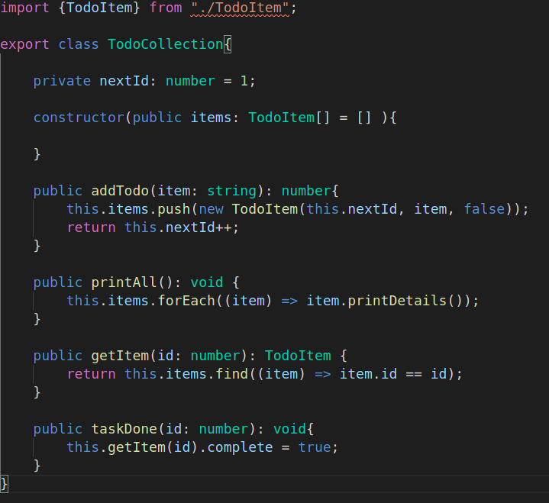
Creating a Todo List:
Collection means set of related objects
Every method provide details of operations to be performed

Slide 6
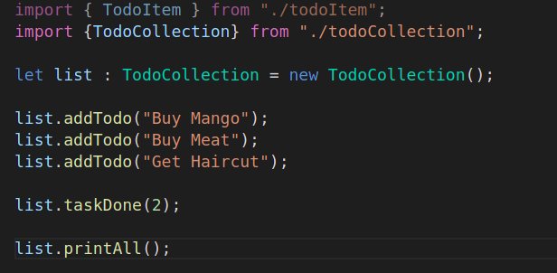
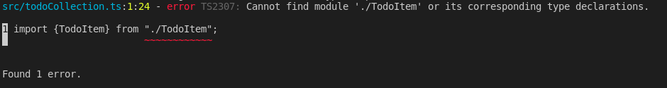
Creating a Todo List:
Creating a Todo List: the index.ts

Slide 7
Creating a Todo List:
Creating a Todo List: Testing, debugging and Running
/FETypeScript/todo$ tsc
src/todoCollection.ts:1:24 - error TS2307: Cannot find module './TodoItem' or its corresponding type declarations.
1 import {TodoItem} from "./TodoItem";
~~~~~~~~~~~~
Found 1 error.
FETypeScript/todo$ tsc
FETypeScript/todo$ ls dist/
index.js todoCollection.js todoItem.js
FETypeScript/todo$ node dist/index.js
1 Buy Mango
2 Buy Meat (complete)
The tsc command is used to trasnspite typescript into javascript. And could also identify error
No error: means transpilation successful
Executing using node

